Slide 1
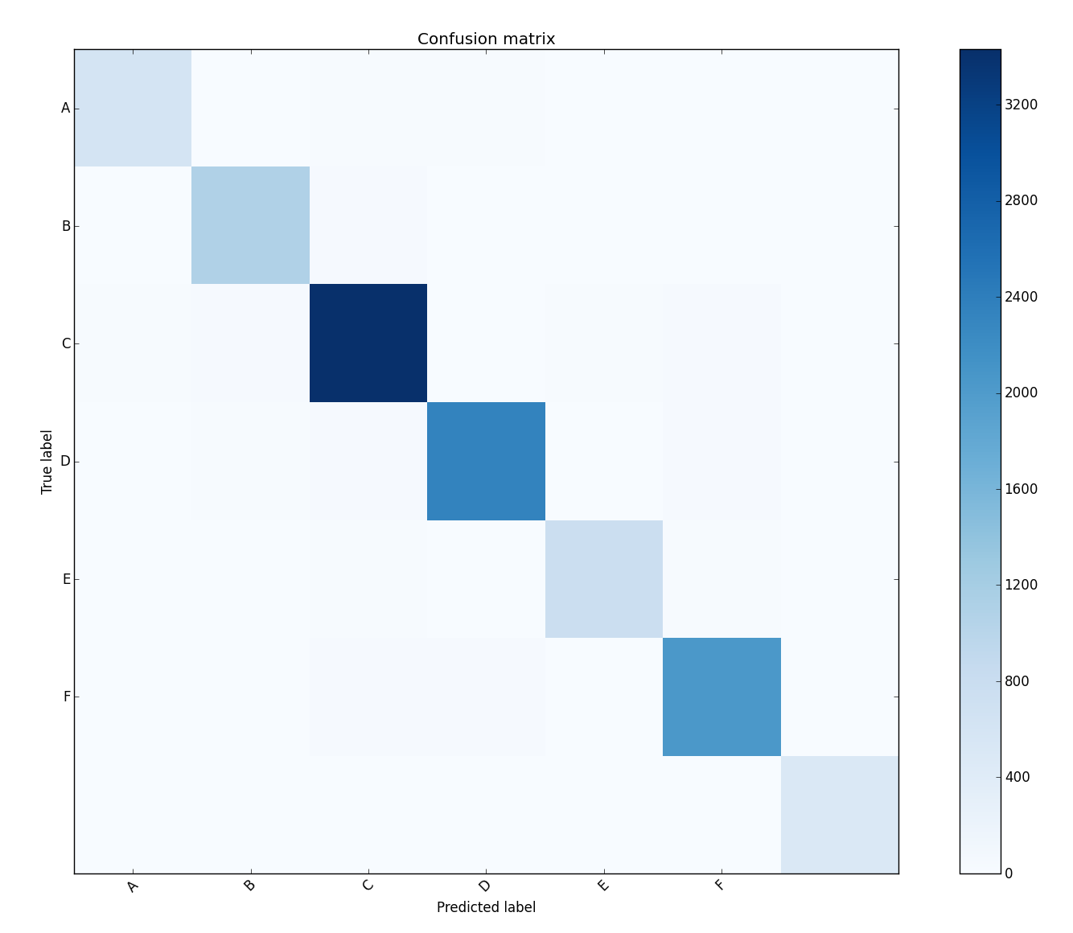
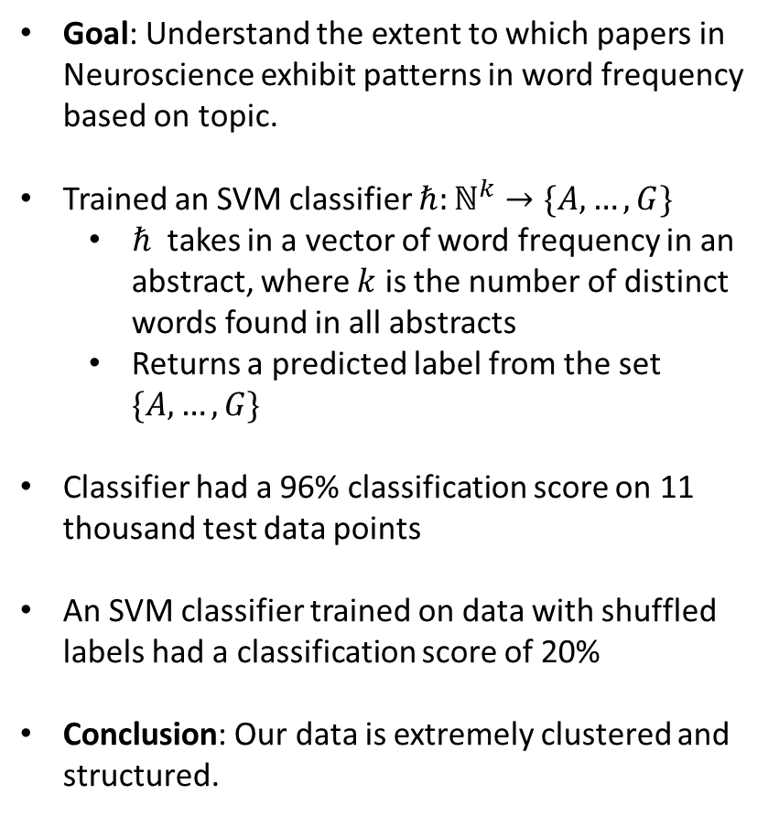
Supervised Learning
Goal: Understand the extent to which papers in Neuroscience exhibit patterns in word frequency based on topic.
Trained an SVM classifier $ℏ:ℕ^{k}→\{A,…,G\}$
$ℏ$ takes in a vector of word frequency in an abstract, where $k$ is the number of distinct words found in all abstracts
Returns a predicted label from the set $\{A,…,G\}$
Classifier had a 96% classification score on 11 thousand test data points
An SVM classifier trained on data with shuffled labels had a classification score of 20%
Conclusion: Our data is extremely clustered and structured.
SVM Classifier (Abstracts)
Test Score: 95.55%
Train Number: 70000
Test Number: 11261
[[ 604 10 14 14 0 2 0]
[ 4 1087 38 6 8 10 8]
[ 20 30 3430 8 17 28 6]
[ 4 22 34 2330 2 28 12]
[ 0 4 14 0 764 16 0]
[ 6 10 30 40 8 2039 8]
[ 4 8 10 12 2 4 506]]

Slide 2
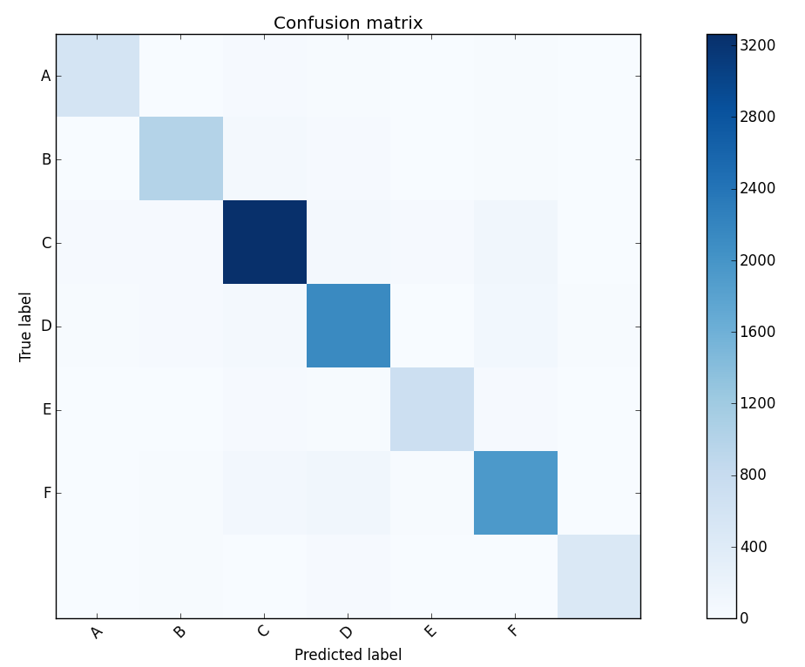
[[ 573 13 32 15 2 18 6]
[ 7 1005 63 32 12 19 12]
[ 28 38 3263 55 32 106 8]
[ 16 28 58 2139 8 97 20]
[ 2 11 39 15 710 29 2]
[ 9 18 90 106 25 1936 14]
[ 7 15 14 29 2 13 470]]
Mean Score: 0.896545599858
Train Number: 70000
Test Number: 11261
SVM Classifier (Titles)

